Slide 1

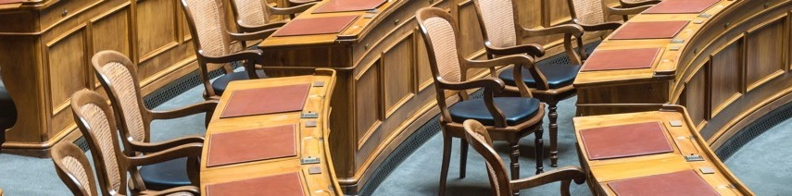
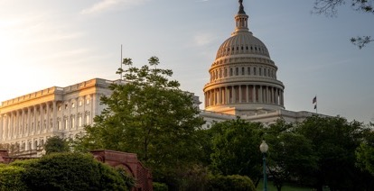
Dynamic Fiscal Notes in the States
Erica MacKellar, NCSL

Slide 2
Goals of the Presentation
The difference between static and dynamic fiscal notes
The history of dynamic fiscal notes and state experiences
The dynamic fiscal note process in Texas, Utah, and Arkansas
Challenges/considerations for producing dynamic fiscal notes

Slide 3
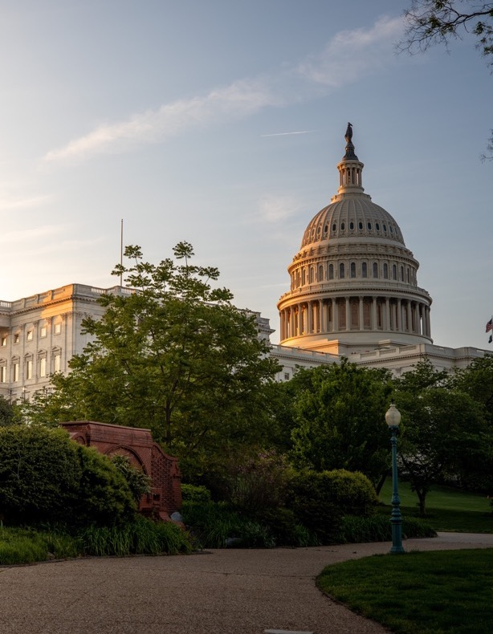
Static Fiscal Notes
Every state except Hawaii produces fiscal notes
Estimate the direct revenue and/or cost of legislation to the state for 1-5 years
Legislation requiring a fiscal note varies by state
Sometimes includes estimated impact to local governments, private sector, or specific populations

Slide 4

Dynamic Fiscal Notes
Attempt to identify the downstream economic effects of a policy change
Most often requested for tax policy bills

Slide 5
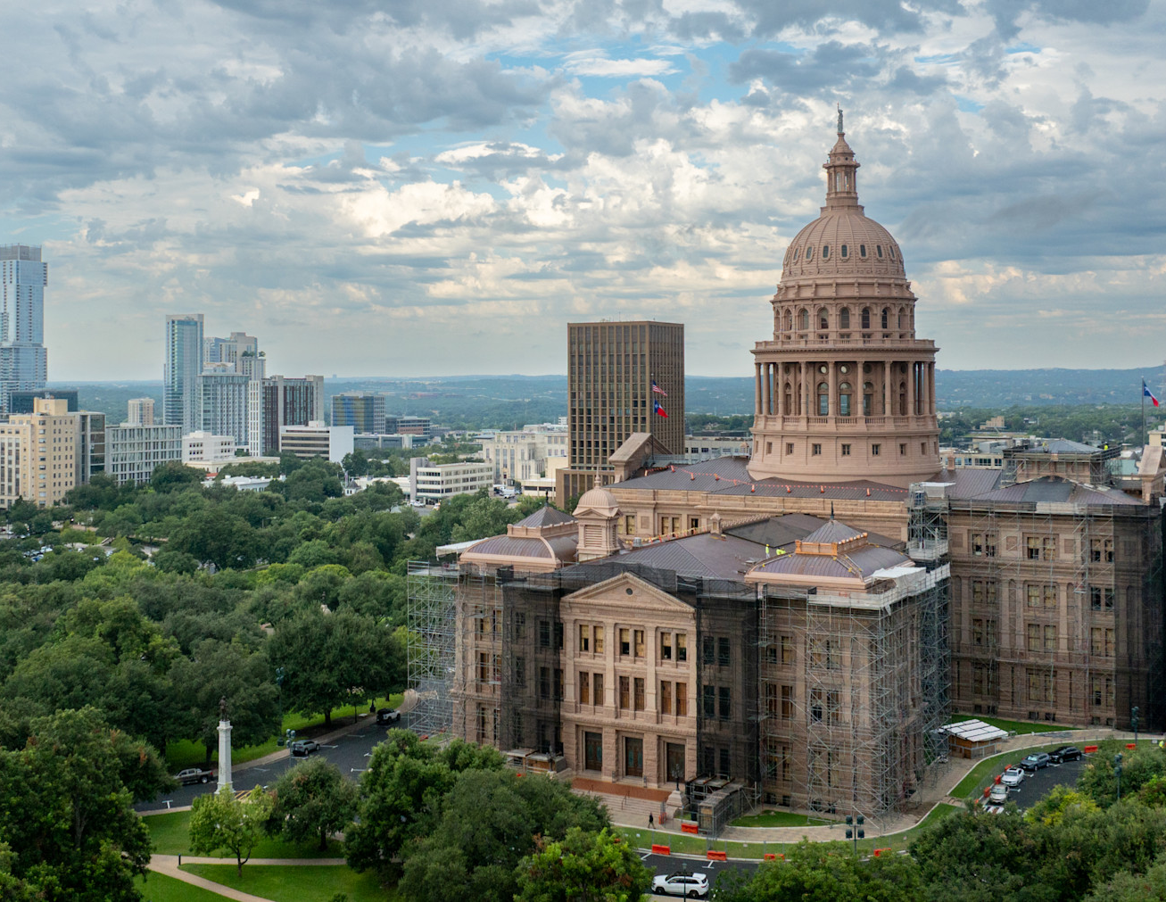
Texas
Dynamic analysis is produced by economists at the Legislative Budget Board (LBB)
Produced for the biennial appropriations bill
Upon request, produced for bills that raise or lower a tax or fee with a threshold of $75 million
Use REMI modeling software

Slide 6

Utah
Produced by economists in the Office of the Legislative Fiscal Analyst
Produced upon member request as resources allow
Only produced during the interim
Not required in statute, code, or rule
Use IMPLAN software

Slide 7
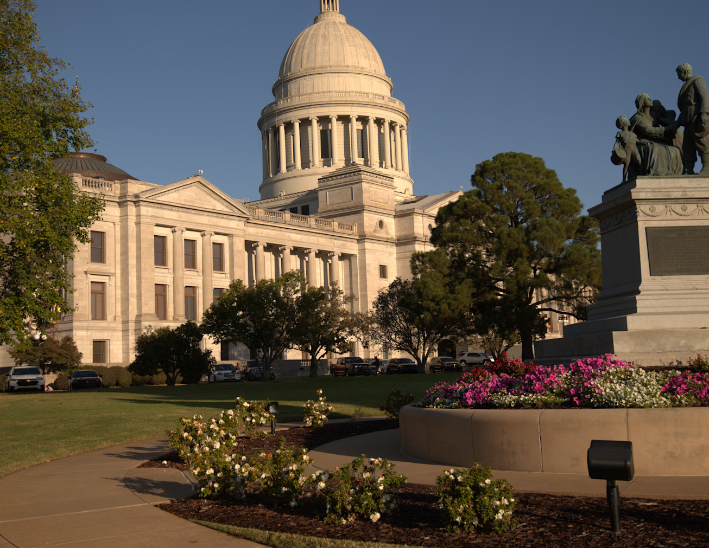
Arkansas
Prepared by economists with the Fiscal Services Division of the Bureau of Legislative Research
Produced last year for the first time
Only at the request of the Speaker or Senate President Pro Tempore
Limit 5 per chamber
Use REMI software

Slide 8
Challenges and Considerations
Staff time and resources
Staff expertise
Assumptions required
Results can be smaller than anticipated
Difficult to determine accuracy
Balanced budget requirements

Slide 9

Thank you for joining today!
Contact Name: Erica MacKellar
Job Title: Program Principal
Email : erica.mackellar@ncsl.org
Phone Number: 303-856-1403
www.ncsl.org
@NCSLorg
Denver 7700 East First Place, Denver CO 80230
Washington D.C.
444 North Capitol Street, N.W. Suite 515, Washington, D.C. 20001

