Slide 1
Cover Page

Slide 2
Tax Expenditure Evaluation
Minnesota Data Center Equipment Exemption
January 15, 2026

Slide 3
Minnesota Data Center Sales Tax Exemption
Authority: Minn. Stat. § 297A.68, subd. 42
Objective: Create Jobs in Construction & Data Center Industries
Eligible Costs: Servers, computer equipment, software, cooling systems, construction materials, and electricity

Slide 4
Data For the Study Was Derived From
Minnesota DEED Application Records
Minnesota DOR
Aterio Consulting
UGA CVIOG Estimates (Electricity Usage)
IMPLAN Estimates (Economics Impacts)

Slide 5
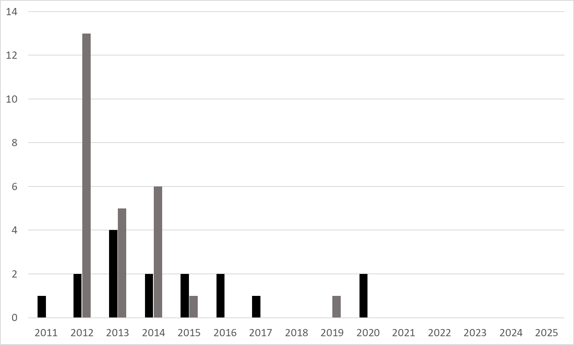
Qualifying New and Refurbished Data Center Projects Between 2011 and 2025
Existing Data Center Refurbishment Projects
New Data Center Construction Projects

Slide 6
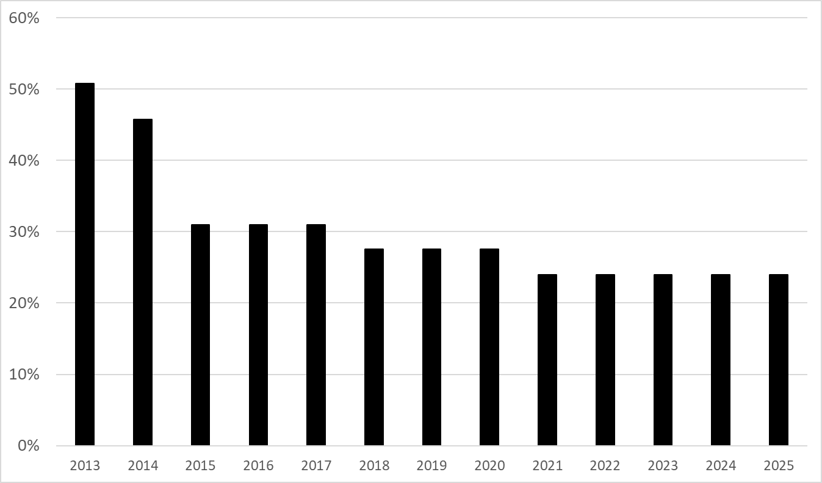
Percent of Data Center Construction Attributed to the Exemption

Slide 7
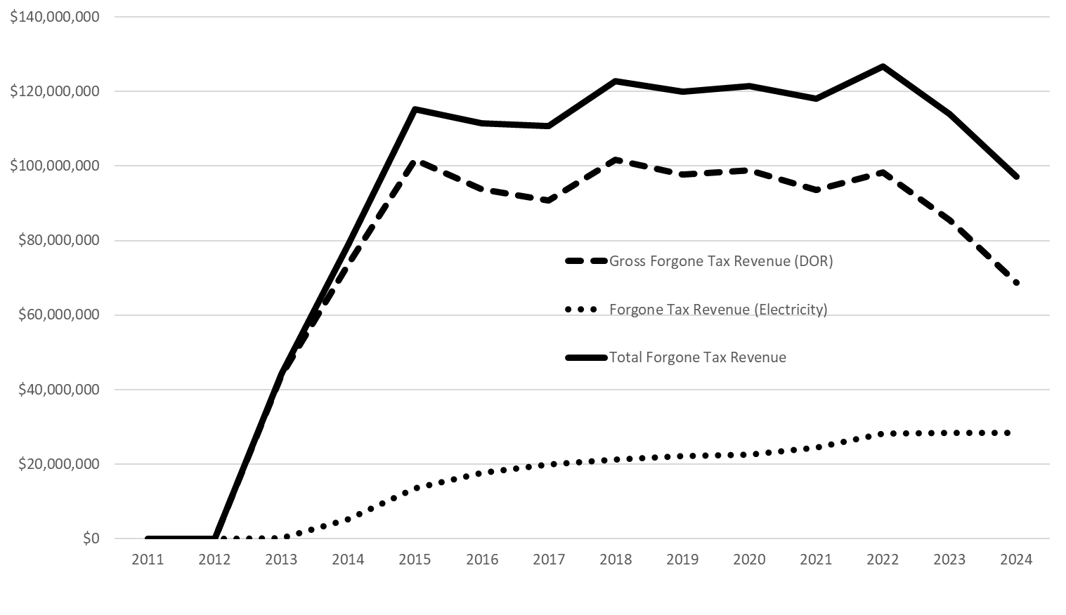
Forgone Sales Tax Revenue from Data Center Construction and Operations

Slide 8
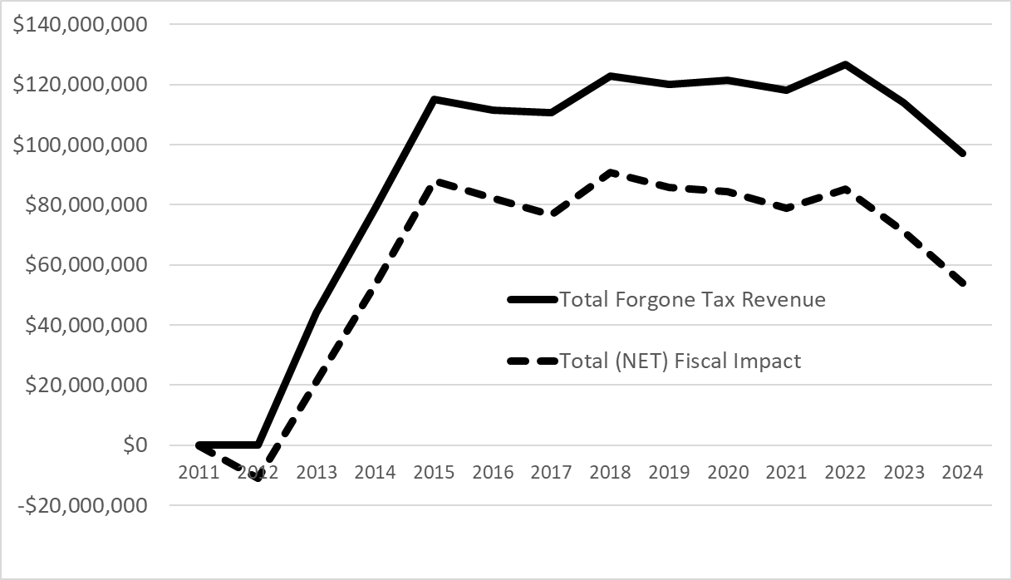
Net Forgone Tax Revenue from Data Center Construction and Operations

Slide 9
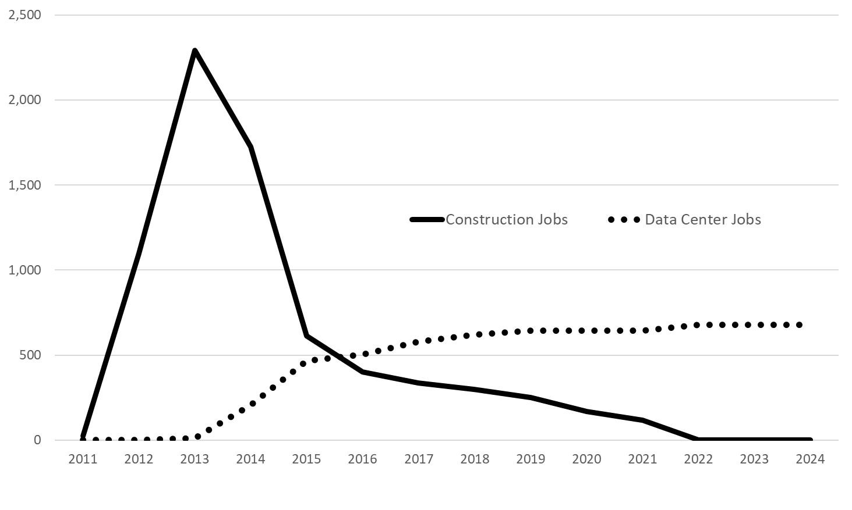
New Construction Jobs and Permanent Data Center Jobs

Slide 10
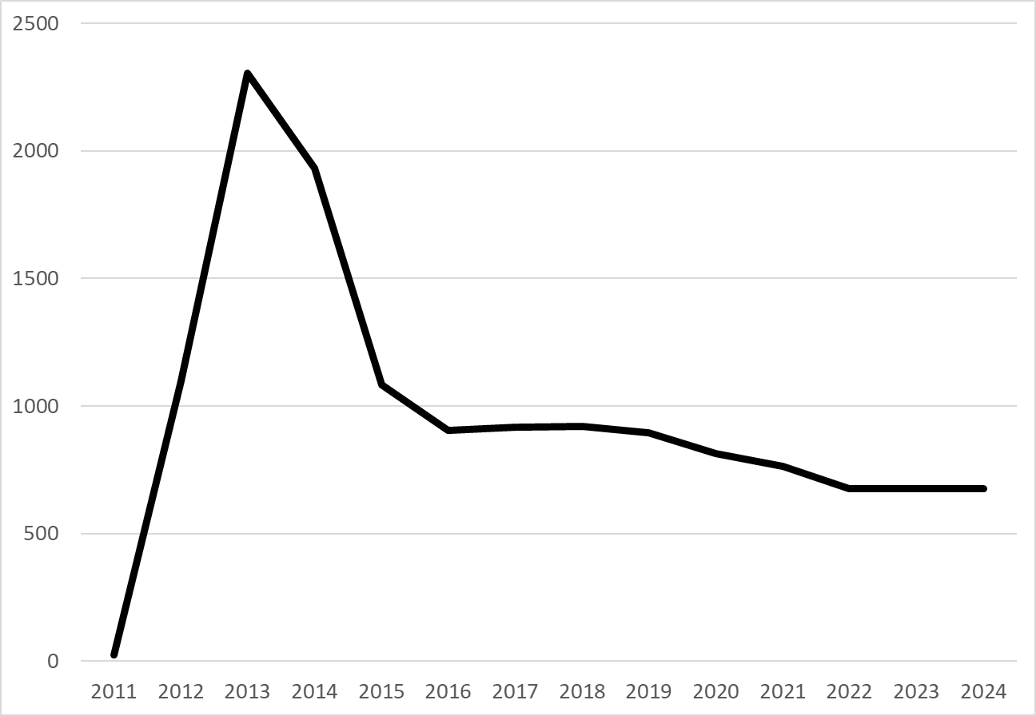
Total Jobs (Construction Jobs Plus Permanent Data Center Jobs)

Slide 11
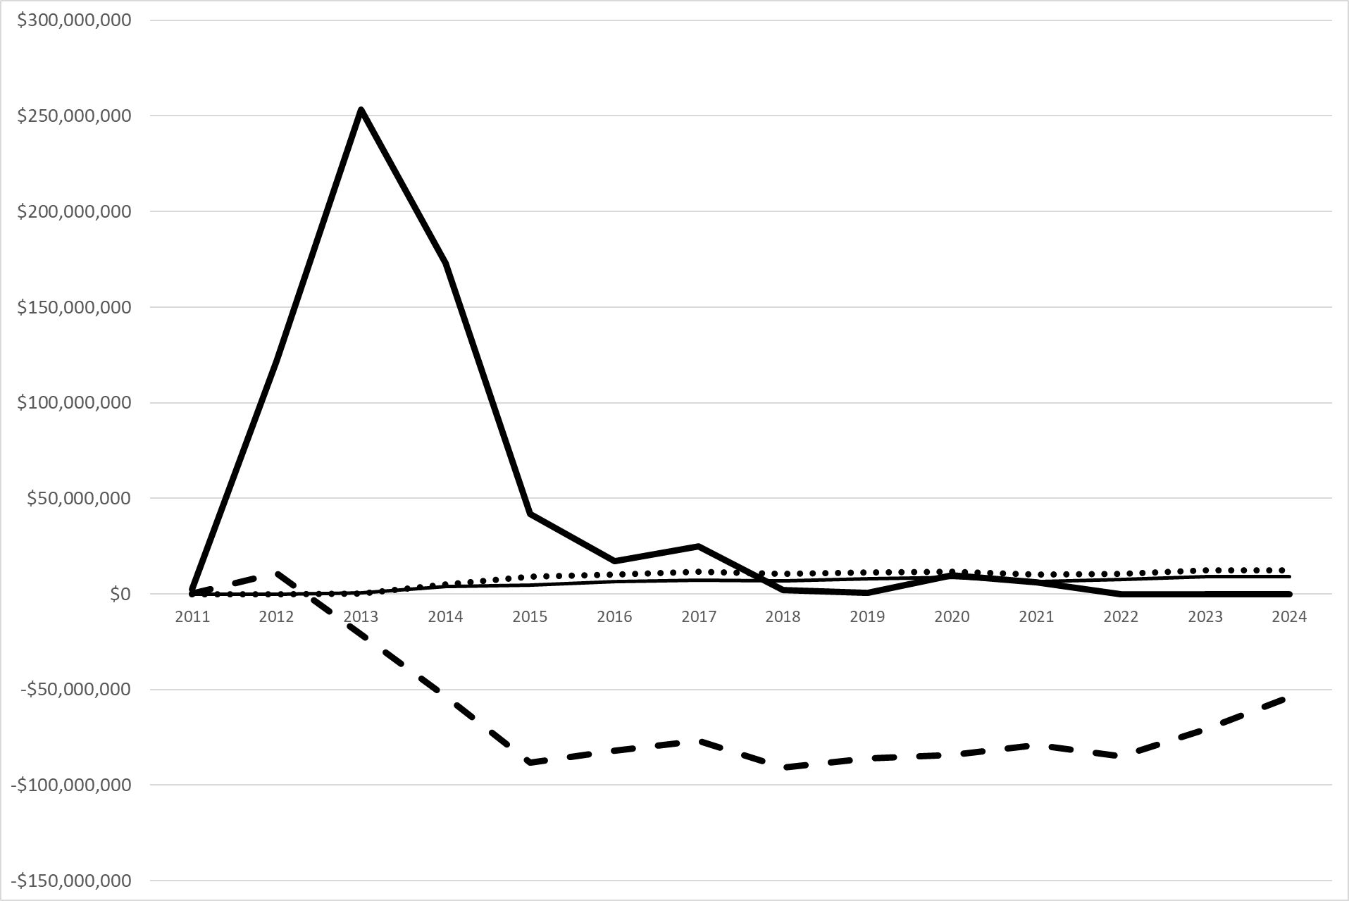
Forgone Tax Revenue v. Economic Impact
Construction & Equipment Impact
Operations Impact
Electricity Generation Impact
Net Fiscal Impact

Slide 12
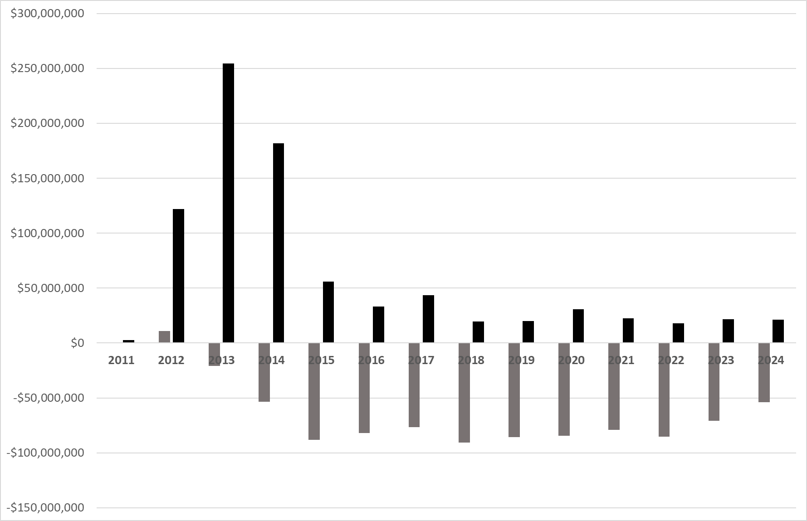
Annual Forgone Tax Revenue v. Economic Impact
Total Annual Economic Impacts
Net Annual Fiscal Impacts

Slide 13
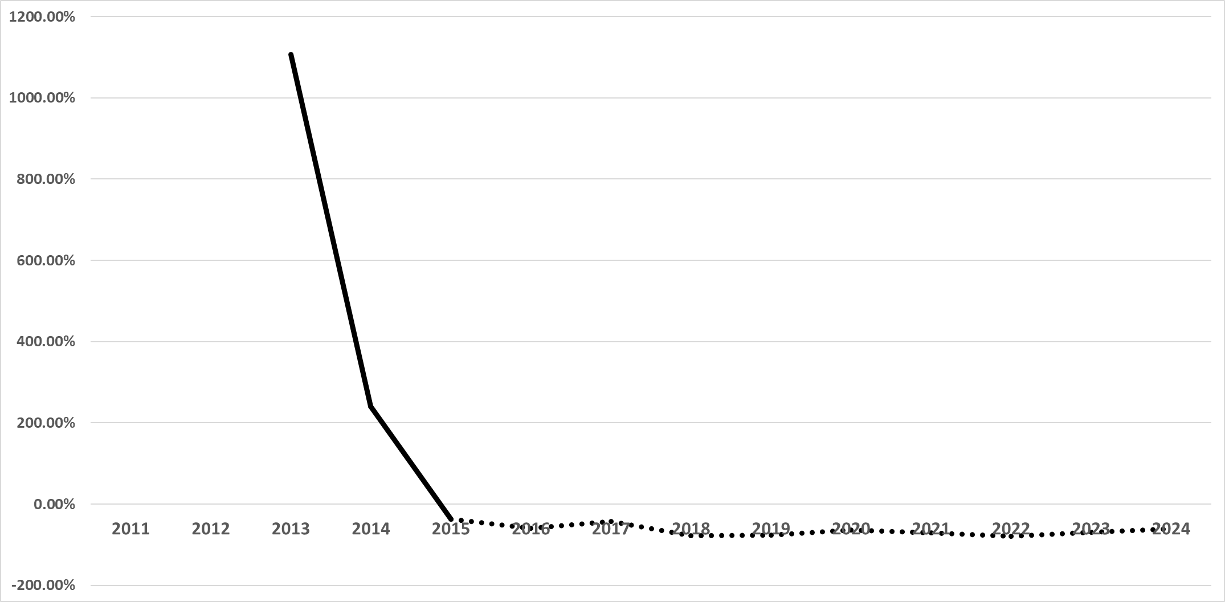

Return on Investment
Positive ROI
Negative ROI

Slide 14
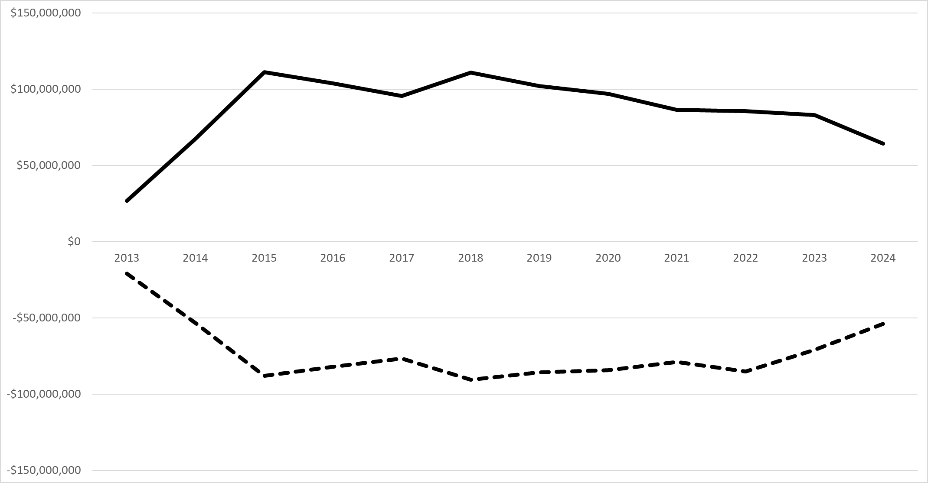
Alternate Use ROI = 18.64%
Alternate Use Impacts & Return on Investment
Alternate Use Impact
Net Forgone Revenue

Slide 15
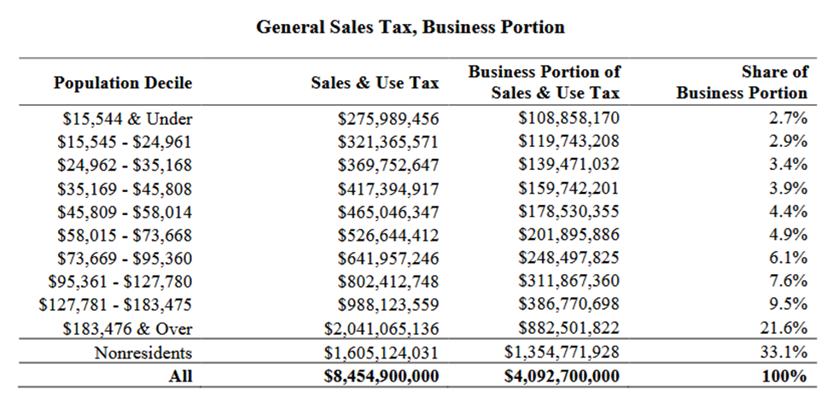
Revenue neutrality, Tax Incidence, and comparative efficiency
Repeal of the exemption would allow the general sales tax rate to decline from 6.875% to approximately 6.787%
Incidence analysis indicates that business sales taxes are disproportionately borne by higher-income households and nonresidents

Slide 16
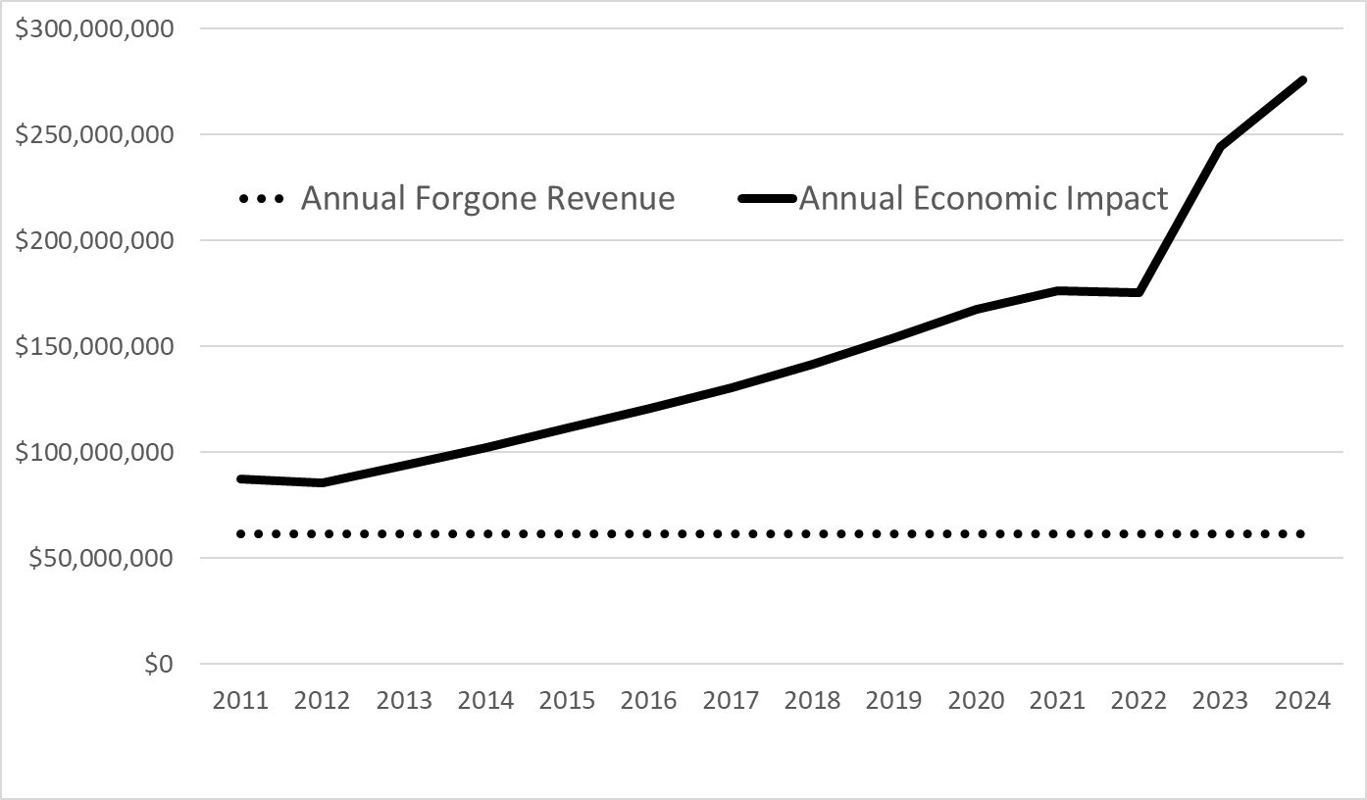
Direct Expenditure Analysis
Direct Expenditure ROI = 140.0%
Assumes Level Spending Targeted towards construction
Assumes no additional sales tax exemptions
Assumes permanent data center jobs grow by 40 per year

Slide 17
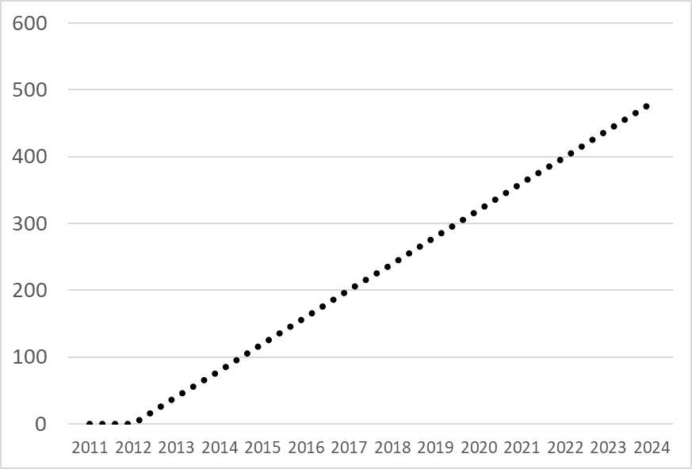
Cumulative Data center jobs drive annual impacts
Cumulative Annual Data Center Jobs
Assumes Level Spending Targeted towards construction
Assumes no additional sales tax exemptions
Assumes permanent data center jobs grow by 40 per year

Slide 18
Permanent data center jobs are cumulative
Cumulative Annual Data Center Jobs
Assumes Level Spending Targeted towards construction
Assumes no additional sales tax exemptions
Assumes permanent data center jobs grow by 40 per year

Slide 19
CVIOG Mission Statement

Slide 20
Connect With Us!

Slide 21
Table a.
 | 2011 | 2012 | 2013 | 2014 | 2015 | 2016 | 2017
Forgone State Tax Revenue | $0 | $0 | -$43,931,000 | -$73,659,000 | -$101,643,000 | -$93,769,000 | -$90,758,000
Increased State Tax Collections from Construction and Equipment | $218,000 | $10,886,000 | $22,595,000 | $17,148,000 | $6,153,000 | $2,522,000 | $4,205,000
Increased State Tax from Elec. Generation | $0 | $0 | $179,000 | $1,097,000 | $1,948,000 | $2,601,000 | $3,248,000
Increased State Tax Collections from Operations | $0 | $0 | $79,000 | $1,952,000 | $5,457,000 | $6,617,000 | $6,674,000
Net Fiscal Impact | $218,000 | $10,886,000 | -$21,078,000 | -$53,462,000 | -$88,085,000 | -$82,029,000 | -$76,631,000

Slide 22
Table a. Continued
 | 2018 | 2019 | 2020 | 2021 | 2022 | 2023 | 2024
Forgone State Tax Revenue | -$101,613,000 | -$97,796,000 | -$98,891,000 | -$93,601,000 | -$98,316,000 | -$85,458,000 | -$68,674,000
Increased State Tax Collections from Construction and Equipment | $358,000 | $137,000 | $919,000 | $1,064,000 | $0 | $0 | $0
Increased State Tax from Elec. Generation | $3,529,000 | $4,277,000 | $7,188,000 | $5,812,000 | $5,205,000 | $5,601,000 | $5,850,000
Increased State Tax Collections from Operations | $7,020,000 | $7,517,000 | $6,467,000 | $7,779,000 | $8,035,000 | $8,852,000 | $8,897,000
Net Fiscal Impact | -$90,706,000 | -$85,865,000 | -$84,317,000 | -$78,946,000 | -$85,076,000 | -$71,005,000 | -$53,927,000

Slide 23
Table b.
 | 2011 | 2012 | 2013 | 2014 | 2015 | 2016 | 2017
Net Forgone State Tax Revenue (Includes Elec.) | $218,000 | $10,886,000 | -$21,078,000 | -$53,462,000 | -$88,085,000 | -$82,028,000 | -$76,631,000
Const and Equip Impact* | $2,494,000 | $121,886,000 | $253,399,000 | $172,947,000 | $41,898,000 | $17,096,000 | $24,782,000
Operations Impact* | $0 | $0 | $218,000 | $4,853,000 | $9,180,000 | $9,965,000 | $11,573,000
Electricity Gen. Impact* | $0 | $0 | $703,000 | $3,894,000 | $4,677,000 | $6,316,000 | $7,313,000
Total Impacts* | $2,494,000 | $121,886,000 | $254,321,000 | $181,695,000 | $55,755,000 | $33,377,000 | $43,668,000
Return on Investment |  |  | 1,106.57% | 239.86% | -36.70% | -59.31% | -43.02%
 | 2018 | 2019 | 2020 | 2021 | 2022 | 2023 | 2024
Net Forgone State Tax Revenue (Includes Elec.) | -$90,706,000 | -$85,865,000 | -$84,317,000 | -$78,946,000 | -$85,076,000 | -$71,005,000 | -$53,927,000
Const and Equip Impact* | $2,052,000 | $631,000 | $9,954,000 | $6,150,000 | $0 | $0 | $0
Operations Impact* | $10,633,000 | $11,266,000 | $11,773,000 | $10,061,000 | $10,348,000 | $12,512,000 | $12,448,000
Electricity Gen. Impact* | $6,983,000 | $8,063,000 | $8,833,000 | $6,386,000 | $7,520,000 | $9,189,000 | $8,955,000
Total Impacts* | $19,668,000 | $19,960,000 | $30,561,000 | $22,597,000 | $17,868,000 | $21,701,000 | $21,403,000
Return on Investment | -78.32% | -76.75% | -63.75% | -71.38% | -79.00% | -69.44% | -60.31%

Slide 24
Table 3.
Impact | Employment | Labor Income | Value-Added | Output
Direct | 2,292 | $223,307,000 | $303,808,000 | $581,831,000
Indirect | 507 | $49,160,000 | $73,496,000 | $156,702,000
Induced | 776 | $47,204,000 | $93,510,000 | $150,780,000
Total | 3,575 | $319,671,000 | $470,814,000 | $889,313,000
Table 4.
Impact | Employment | Labor Income | Value-Added | Output
Direct | 677 | $57,134,000 | $75,698,000 | $141,202,000
Indirect | 315 | $25,540,000 | $40,819,000 | $72,238,000
Induced | 385 | $25,905,000 | $47,784,000 | $77,477,000
Total | 1,377 | $108,579,000 | $164,301,000 | $290,917,000

Slide 25
Table 5.
 | 2011 | 2012 | 2013 | 2014 | 2015 | 2016 | 2017
Construction and Equip Impact | $4,913,000 | $240,078,000 | $499,118,000 | $377,786,000 | $135,400,000 | $55,250,000 | $80,087,000
Operations Impact | $0 | $0 | $430,000 | $10,601,000 | $29,667,000 | $32,204,000 | $37,400,000
Electricity Generation Impact | $0 | $0 | $1,385,000 | $8,507,000 | $15,114,000 | $20,411,000 | $23,633,000
 | 2018 | 2019 | 2020 | 2021 | 2022 | 2023 | 2024
Construction and Equip Impact | $7,436,000 | $2,286,000 | $36,073,000 | $25,624,000 | $0 | $0 | $0
Operations Impact | $38,532,000 | $40,826,000 | $42,665,000 | $41,916,000 | $43,113,000 | $52,130,000 | $51,861,000
Electricity Generation Impact | $25,306,000 | $29,220,000 | $32,011,000 | $26,604,000 | $31,330,000 | $38,283,000 | $37,310,000

Slide 26
Table 6.
 | 2011 | 2012 | 2013 | 2014 | 2015 | 2016 | 2017
Net Forgone State Tax Revenue (Includes Elec) | $218,000 | $10,886,000 | -$21,078,000 | -$53,462,000 | -$88,085,000 | -$82,028,000 | -$76,631,000
Const and Equip Impact* | $2,494,000 | $121,886,000 | $253,399,000 | $172,947,000 | $41,898,000 | $17,096,000 | $24,782,000
Operations Impact* | $0 | $0 | $218,000 | $4,853,000 | $9,180,000 | $9,965,000 | $11,573,000
Electricity Gen. Impact* | $0 | $0 | $703,000 | $3,894,000 | $4,677,000 | $6,316,000 | $7,313,000
Total Impacts* | $2,494,000 | $121,886,000 | $254,321,000 | $181,695,000 | $55,755,000 | $33,377,000 | $43,668,000
Return on Investment |  |  | 1,106.57% | 239.86% | -36.70% | -59.31% | -43.02%
 | 2018 | 2019 | 2020 | 2021 | 2022 | 2023 | 2024
Net Forgone State Tax Revenue (Includes Elec) | -$90,706,000 | -$85,865,000 | -$84,317,000 | -$78,946,000 | -$85,076,000 | -$71,005,000 | -$53,927,000
Const and Equip Impact* | $2,052,000 | $631,000 | $9,954,000 | $6,150,000 | $0 | $0 | $0
Operations Impact* | $10,633,000 | $11,266,000 | $11,773,000 | $10,061,000 | $10,348,000 | $12,512,000 | $12,448,000
Electricity Gen. Impact* | $6,983,000 | $8,063,000 | $8,833,000 | $6,386,000 | $7,520,000 | $9,189,000 | $8,955,000
Total Impacts* | $19,668,000 | $19,960,000 | $30,561,000 | $22,597,000 | $17,868,000 | $21,701,000 | $21,403,000
Return on Investment | -78.32% | -76.75% | -63.75% | -71.38% | -79.00% | -69.44% | -60.31%

Slide 27
Table 7.
Impact | Employment | Labor Income | Value-Added | Output
Direct | 368 | $32,931,000 | $40,752,000 | $48,278,000
Indirect | 27 | $2,346,000 | $3,765,000 | $6,926,000
Induced | 160 | $10,735,000 | $19,804,000 | $32,111,000
Total | 555 | $46,012,000 | $64,321,000 | $87,315,000

Slide 28
Table 8.
 | 2013 | 2014 | 2015 | 2016 | 2017 | 2018
Net Forgone State Tax Revenue (Includes Elec) | -$21,078,000 | -$53,462,000 | -$88,085,000 | -$82,029,000 | -$76,631,000 | -$90,706,000
Alternate Use Impact | $26,606,000 | $67,485,000 | $111,187,000 | $103,747,000 | $95,575,000 | $110,928,000
Return on Investment | 26.23% | 26.23% | 26.23% | 26.48% | 24.72% | 22.29%
 | 2019 | 2020 | 2021 | 2022 | 2023 | 2024
Net Forgone State Tax Revenue (Includes Elec) | -$85,865,000 | -$84,317,000 | -$78,946,000 | -$85,076,000 | -$71,005,000 | -$53,927,000
Alternate Use Impact | $101,911,000 | $96,906,000 | 86,338,000 | 85,443,000 | $83,109,000 | $64,268,000
Return on Investment | 18.69% | 14.93% | 9.36% | 0.43% | 17.05% | 19.18%

Slide 29
Table 9.
 | 2011 | 2012 | 2013 | 2014 | 2015 | 2016 | 2017
Net Forgone State Tax Revenue (Includes Elec) | $218,000 | $10,886,000 | -$21,078,000 | -$53,462,000 | -$88,085,000 | -$82,029,000 | -$76,631,000
Const and Equip Impact* | $2,494,000 | $121,886,000 | $253,399,000 | $172,947,000 | $41,898,000 | $17,096,000 | $24,782,000
Operations Impact* | $0 | $0 | $218,000 | $4,853,000 | $9,180,000 | $9,965,000 | $11,573,000
Electricity Gen. Impact* | $0 | $0 | $703,000 | $3,894,000 | $4,677,000 | $6,316,000 | $7,313,000
Total Impacts* | $2,494,000 | $121,886,000 | $254,321,000 | $181,695,000 | $55,755,000 | $33,377,000 | $43,668,000
Exemption Return on Investment |  |  | 1,106.57% | 239.86% | -36.70% | -59.31% | -43.02%
Alternate Use Impact |  |  | $26,606,000 | $67,485,000 | $111,187,000 | $103,747,000 | $95,575,000
Alternate Use Return on Investment |  |  | 26.23% | 26.23% | 26.23% | 26.48% | 24.72%
 | 2018 | 2019 | 2020 | 2021 | 2022 | 2023 | 2024
Net Forgone State Tax Revenue (Includes Elec) | -$90,706,000 | -$85,865,000 | -$84,317,000 | -$78,946,000 | -$85,076,000 | -$71,005,000 | -$53,927,000
Const and Equip Impact* | $2,052,000 | $631,000 | $9,954,000 | $6,150,000 | $0 | $0 | $0
Operations Impact* | $10,633,000 | $11,266,000 | $11,773,000 | $10,061,000 | $10,348,000 | $12,512,000 | $12,448,000
Electricity Gen. Impact* | $6,983,000 | $8,063,000 | $8,833,000 | $6,386,000 | $7,520,000 | $9,189,000 | $8,955,000
Total Impacts* | $19,668,000 | $19,960,000 | $30,561,000 | $22,597,000 | $17,868,000 | $21,701,000 | $21,403,000
Exemption Return on Investment | -78.32% | -76.75% | -63.75% | -71.38% | -79.00% | -69.44% | -60.31%
Alternate Use Impact | $110,928,000 | $101,911,000 | $96,906,000 | 86,338,000 | 85,443,000 | $83,109,000 | $64,268,000
Alternate Use Return on Investment | 22.29% | 18.69% | 14.93% | 9.36% | 0.43% | 17.05% | 19.18%

Slide 30
Table 10.
 | 2011 | 2012 | 2013 | 2014 | 2015 | 2016 | 2017
Forgone State Tax Revenue | $0 | $0 | -$43,931,000 | -$73,659,000 | -$101,643,000 | -$93,769,000 | -$90,758,000
Increased State Tax Collections from Construction and Equipment | $218,000 | $10,886,000 | $22,595,000 | $17,148,000 | $6,153,000 | $2,522,000 | $4,205,000
Increased State Tax from Elec. Generation | $0 | $0 | $179,000 | $1,097,000 | $1,948,000 | $2,601,000 | $3,248,000
Increased State Tax Collections from Operations | $0 | $0 | $79,000 | $1,952,000 | $5,457,000 | $6,617,000 | $6,674,000
Net Fiscal Impact | $218,000 | $10,886,000 | -$21,078,000 | -$53,462,000 | -$88,085,000 | -$82,029,000 | -$76,631,000
 | 2018 | 2019 | 2020 | 2021 | 2022 | 2023 | 2024
Forgone State Tax Revenue | -$101,613,000 | -$97,796,000 | -$98,891,000 | -$93,601,000 | -$98,316,000 | -$85,458,000 | -$68,674,000
Increased State Tax Collections from Construction and Equipment | $358,000 | $137,000 | $919,000 | $1,064,000 | $0 | $0 | $0
Increased State Tax from Elec. Generation | $3,529,000 | $4,277,000 | $7,188,000 | $5,812,000 | $5,205,000 | $5,601,000 | $5,850,000
Increased State Tax Collections from Operations | $7,020,000 | $7,517,000 | $6,467,000 | $7,779,000 | $8,035,000 | $8,852,000 | $8,897,000
Net Fiscal Impact | -$90,706,000 | -$85,865,000 | -$84,317,000 | -$78,946,000 | -$85,076,000 | -$71,005,000 | -$53,927,000

Slide 31
Table 1.
Requirement/Feature | Details (2025)
Eligible Purchases (Exempted Items) | - Computer equipment and hardware (servers, cooling, power infrastructure, racks, etc.) - Computer software (including upgrades and replacements)
Exemption Mechanism | - Sales tax is paid at purchase and then refunded under the Minnesota refund process.
Facilities That Qualify | - New data centers: at least 25,000 sq ft in one or more buildings on a single or contiguous parcel; at least $30 million in construction + equipment + software investment within 48 months - Refurbished data centers: at least 25,000 sq ft rebuilt or modified; at least $50 million in investment into refurbishment + equipment/software within 24 months; the data center must have: uninterruptible power supplies or generator backup (or both), fire-suppression/prevention systems, and enhanced security
New “Large-Scale Data Center” Category (2025) Duration of Exemption (Tax-free window) Electricity Treatment (2025) Sustainability, Environmental & Labor Requirements (2025) Sunset / Expiration of Program Administration / Certification | As of June 30, 2025, Minnesota recognizes a new class: “qualified large-scale data centers”. To qualify: at least 25,000 sq ft (one or more buildings connected by fiber), and a collective investment of at least $250 million (construction/refurbishment + IT equipment + software) by the facility and its tenants within a 60-month period beginning after June 30, 2025. Beginning in 2025, qualified data centers (new, refurbished, or large-scale) may claim the sales-tax exemption for 35 years after the first qualifying purchase. The law repealed the sales and use tax exemption for electricity used or consumed by data centers. Starting July 1, 2025, electricity is no longer exempt. For large-scale data centers: within three years of being placed in service, the facility must be certified under one or more specified sustainable-design or green-building standards. If it fails to meet that requirement, the data center must repay the tax exemptions. The previous statutory sunset of July 1, 2042 was extended. The exemption lasts 35 years from first qualifying purchase. Data centers certified before July 1, 2042 may continue for up to 35 years. Qualifying data centers must be certified by the Minnesota DEED.

